Slide 1
Aravind Ravi
User Experience Designer

Slide 2



BACKGROUND
B. Tech. - Information & Communication Technology
(Jun ‘07 – May ‘11)
UX Designer & Front-end Developer
(Jan ‘11 – Aug ‘14)
M.S. – Human Centered Design & Engineering
(Sep ‘14 – Present)
User Experience Designer
(Jun ‘15 – Present)

Slide 3

Problem:
Redesigning experience of banking operations for customers to make it more engaging, informative and useful
Roles:
Interaction Design
Visual Design
Prototyping
Impact:
Millions of Dollars in savings for Citi
New business channels
Customer behavior tracking and analytics
Shift in focus in Tata towards more UX improvements
Spinoff:
Product for Banking Organizations – Patent Pending
Nov ‘11 – Apr ‘13
Notes:
Work presented to CTOs and CFOs of different Banking and Financial Organizations such as
BoA, Amex, Barclays, RBS …
2 Principal consultants
3 Associate Consultants
3 Sr. Developers
2 Visual Designers

Slide 4

Problem:
Conceptualizing a mobile application for their existing business
Roles:
Interaction Design
Visual Design
Front-end Development
Impact:
Process Improvements
Mobile channel for business
New projects for Tata Consultancy Services
May ‘13 – Nov ‘13

Slide 5


Problem:
Mobilizing and automating presales process to improve turnaround time for service installation, reduce manual processes and produce cost savings
Roles:
Lead UX Designer
Front-end Development
Usability Testing
Impact:
Millions of Dollars in savings for Citi
New business channels
Customer behavior tracking and analytics
Shift in focus in Tata towards more UX improvements
Spinoff:
Product for Banking Organizations – Patent Pending
Dec ‘13 – Aug ‘14
Notes:
Worked with:
2 Business Analysts from VM
3 Software Architects from VM
3 Senior consultants from Tata
2 .NET developers
1 Visual designer

Slide 6

Graphic Design
(Dec ‘14 – Mar ‘15)
Usability Testing
(Jan ‘15 – Mar ‘15)

Slide 8
Agenda

Slide 9
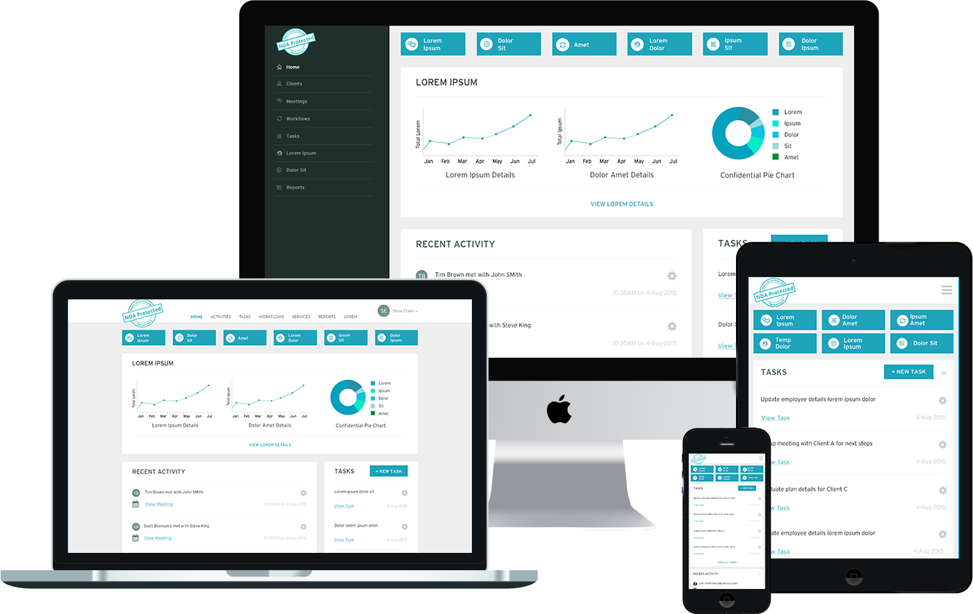
Overview
Introduction
Team & Roles
Project Goals
Summer 2015
UX Design Intern

Slide 10




Overview
Introduction
Team & Roles
Project Goals
Customer Retention & Engagement
Workflow Automation
Eliminating Technology Fragmentation
Process Improvements

Slide 11

Overview
Introduction
Team & Roles
Project Goals
The Team
Jeff Dance
CEO
Richard Rose
CFO
Teage Christensen
Project Manager
Aravind (Me)
UX Designer
My Roles
User Research
Interaction Design
Visual Design

Slide 12
Research
Interviews
Competitive Analysis
Survey
“Wishlist”
“everything in
1 place”
“Most brokers don’t do that extra work that we do”
“Automate”
“Pareto’s Principle”
“get to the market quickly”
“team collaboration”
“Highlight what
differentiates us”
“1-click solution”
“scheduling meetings”

Slide 13
Research
Interviews
Competitive Analysis
Survey

Slide 14
Research
Interviews
Competitive Analysis
Survey
20
Leading Products Identified
12
Products evaluated by specifications
5
Deep Dives
2
Shortlisted

Slide 15
Process Summary
Initially Planned
What I Ended Up Doing
Get Form Fields
Understand the problems
Competitive Analysis
System Flows
Wireframes
Process Modeling
Design Goals
Sketching
Usability Testing
Affinity Maps
Ideation
Wireframing
Prototyping
Process Modeling
System Flows
Cognitive Walkthrough
Notes:
Avoiding premature convergence
Building right product vs building product right

Slide 16
Analysis
Process Modeling
Strategy
Affinity Maps

Slide 17
Analysis
Process Modeling
Strategy
Affinity Maps

Slide 18
Analysis
Process Modeling
Strategy
Affinity Maps
Product A
CRM Application
Benefits
Workflow Management
Meeting Scheduling
401K
Task Management
Discussions
Employee Onboarding
Meeting Notes
Analytics & Reports
Payroll / PTO
API

Slide 19
Design Considerations
Constraints
Personas

Slide 20

Design Considerations
Constraints
Personas
Budget and timelines
API Limitations
Business Requirements
Technical Budget Limitation
Balancing Business and User needs
Cultural backgrounds of users

Slide 21
Design
Sketches
Wireframes
Prototypes
Interaction Model

Slide 22
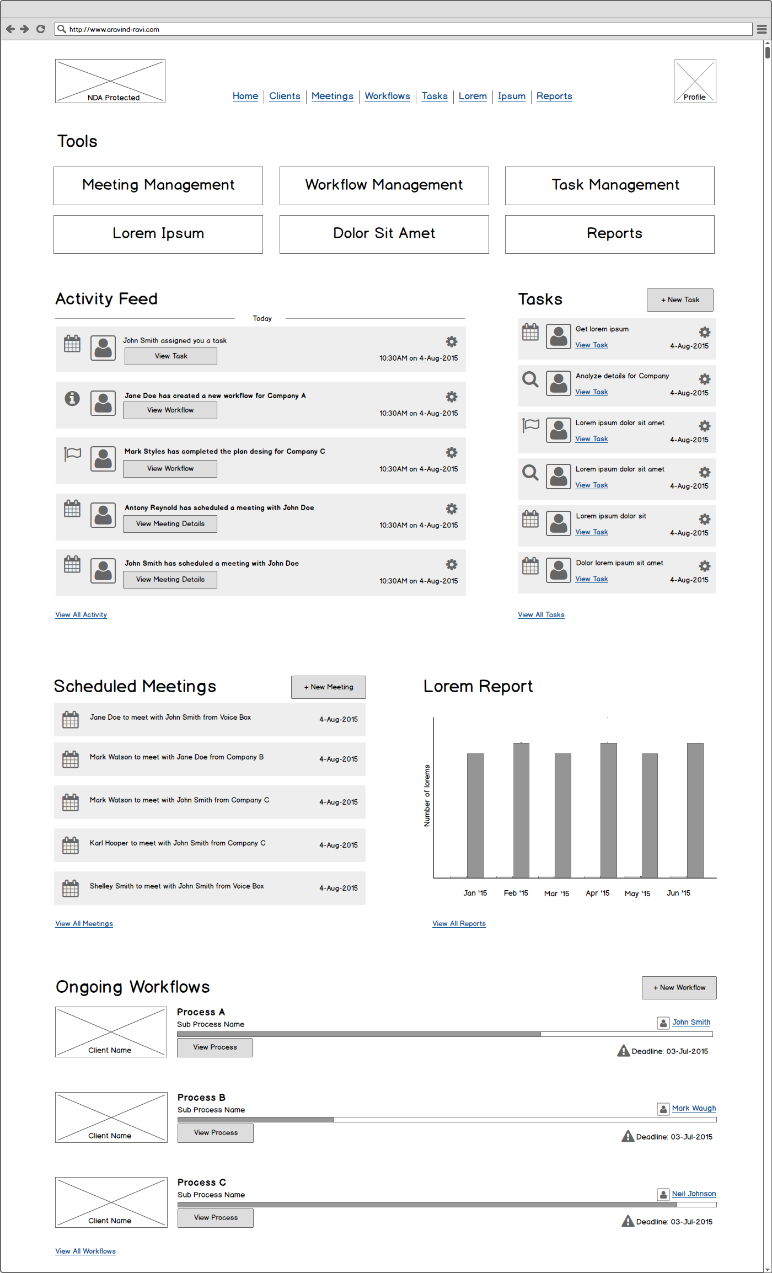
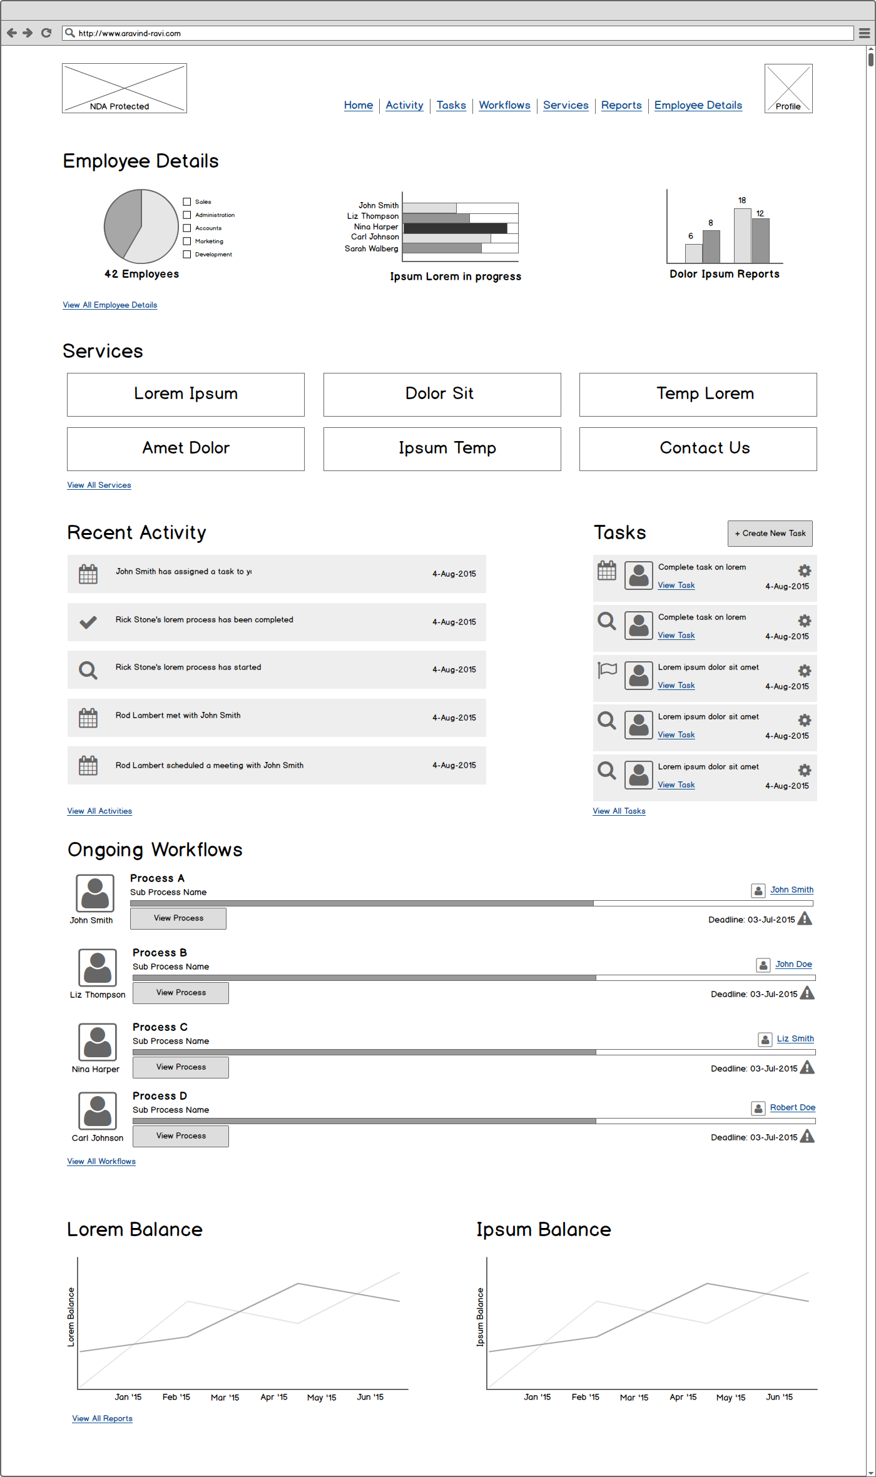
Advisor Dashboard
HR Dashboard
Annotate!!!!!!

Slide 23
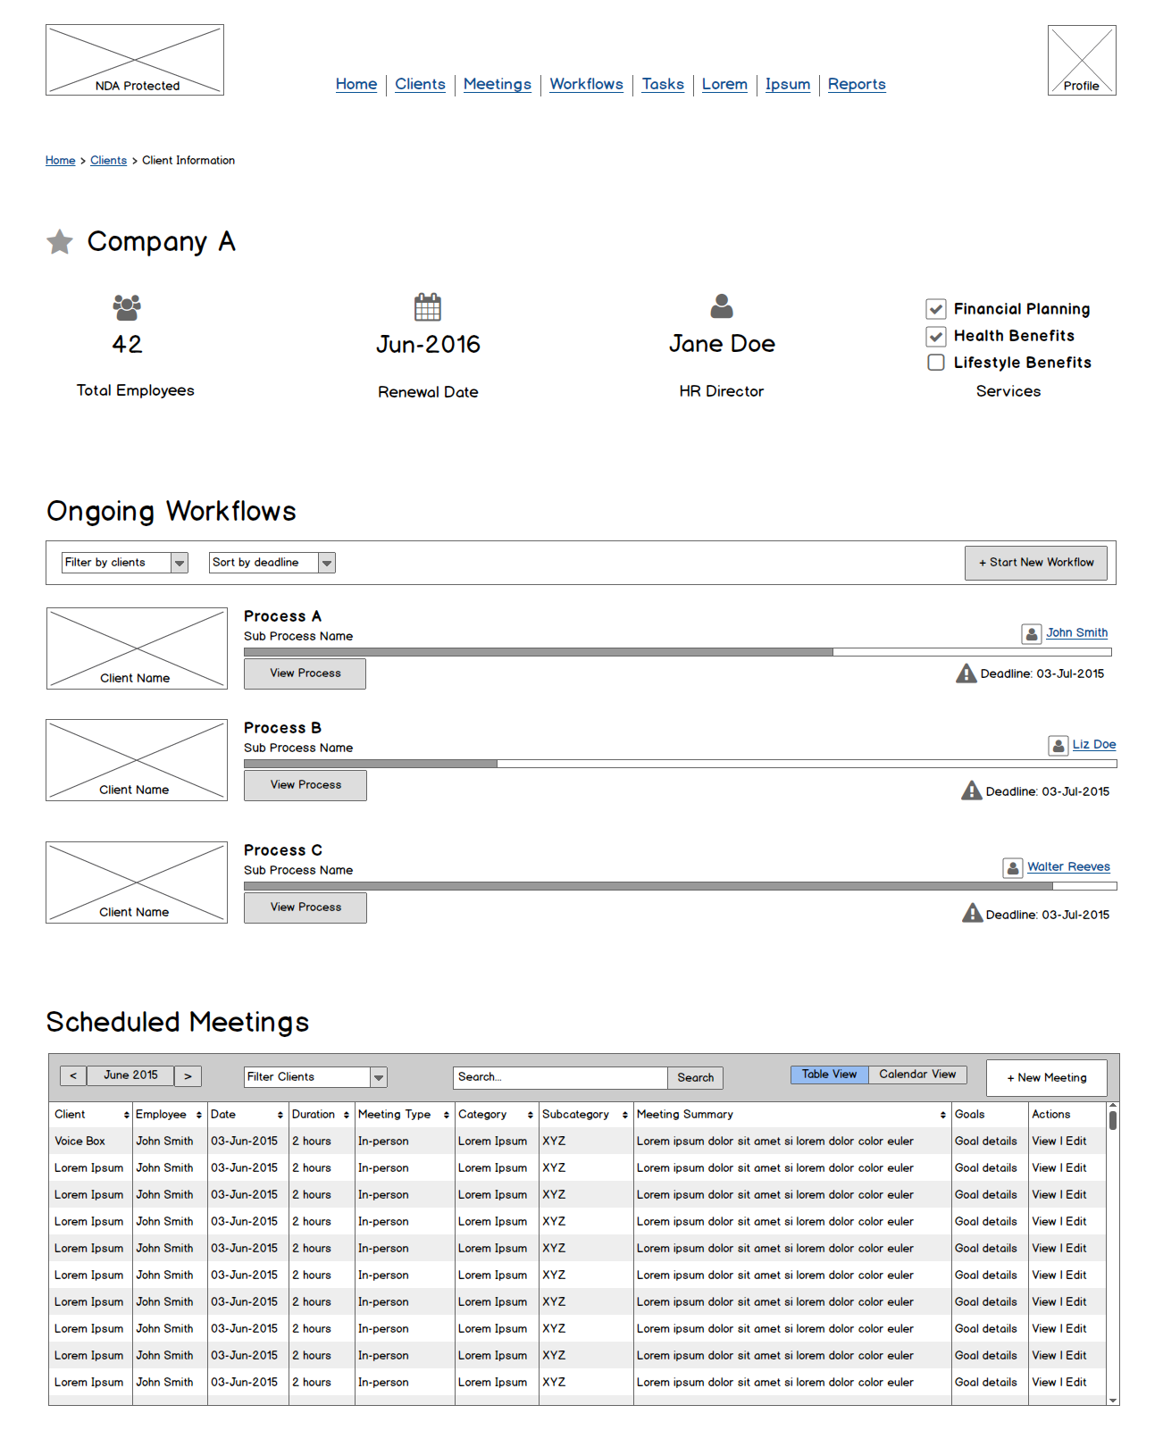
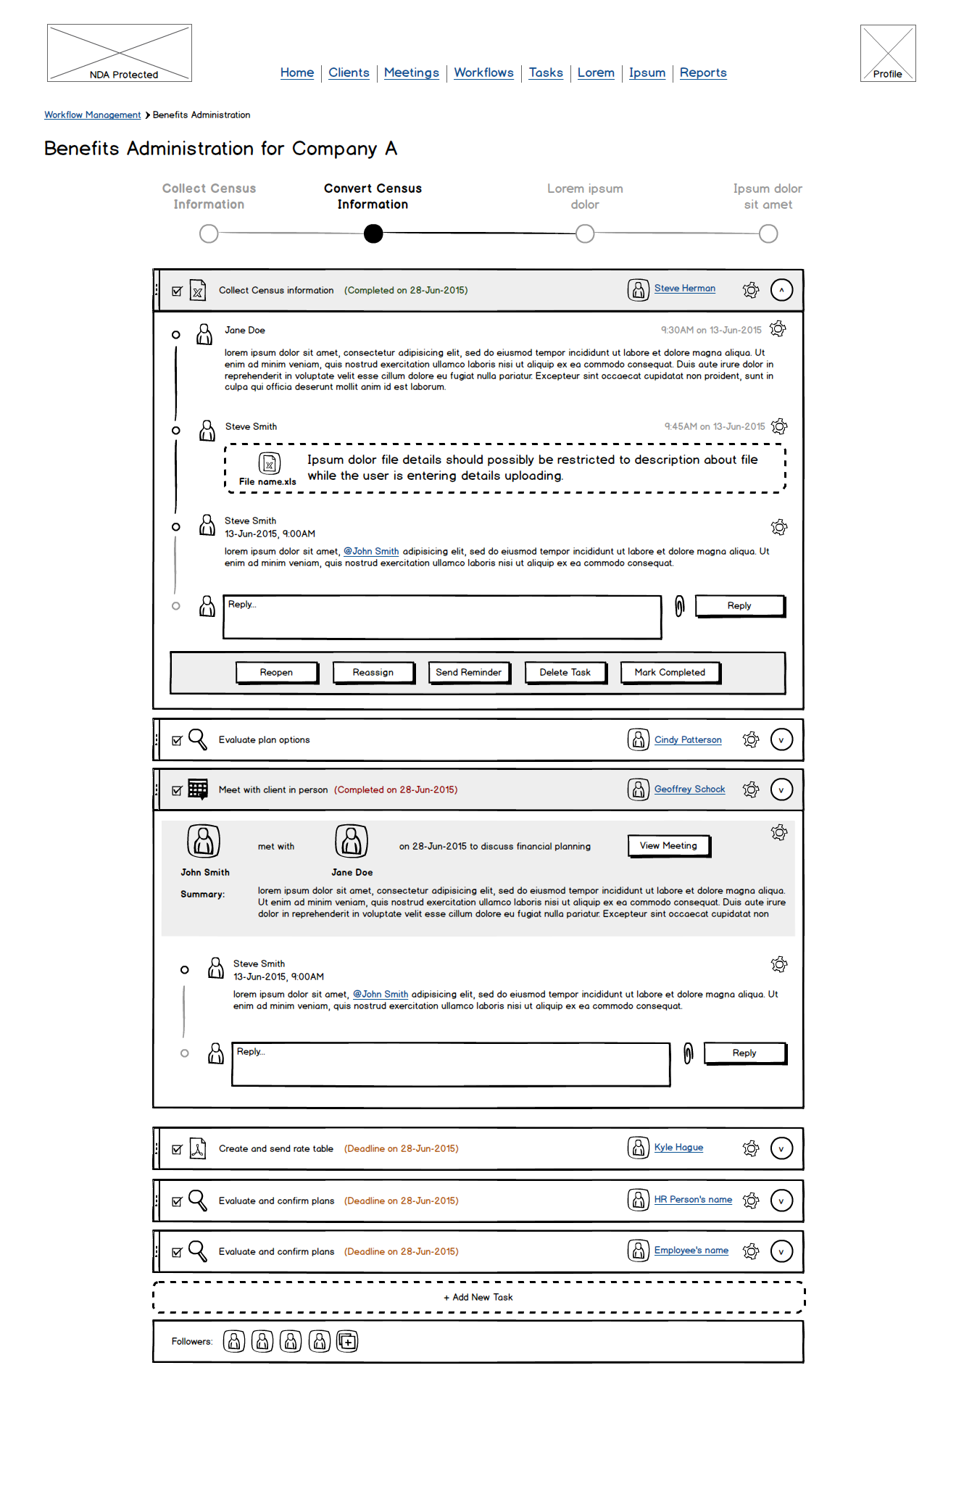
Client Information
Workflow Management

Slide 24
Advisor Dashboard
HR Dashboard

Slide 25
Design
Sketches
Wireframes
Prototypes

Slide 26
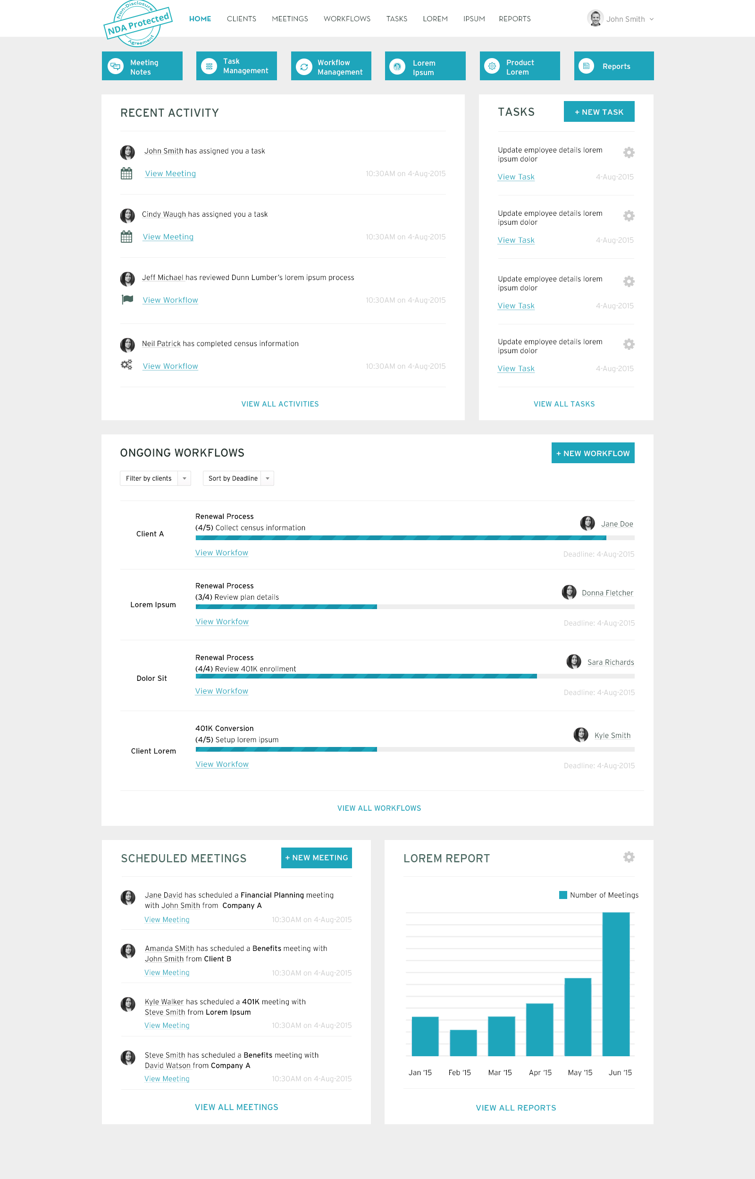
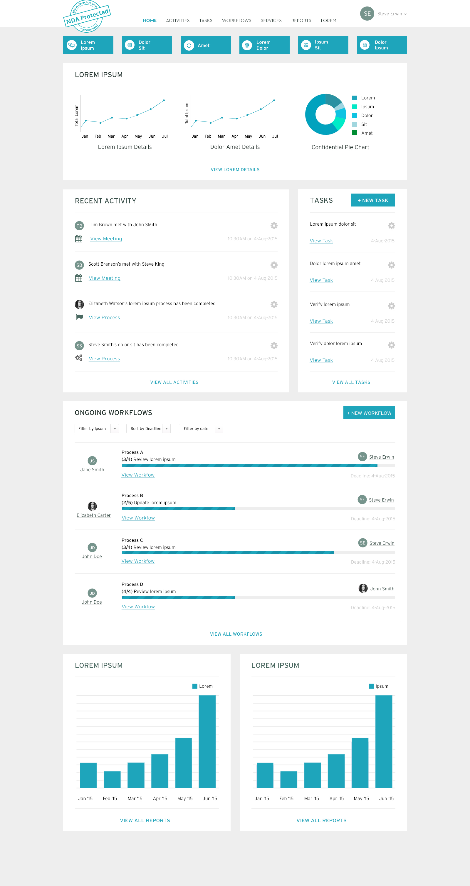
Advisor Dashboard
HR Dashboard

Slide 27
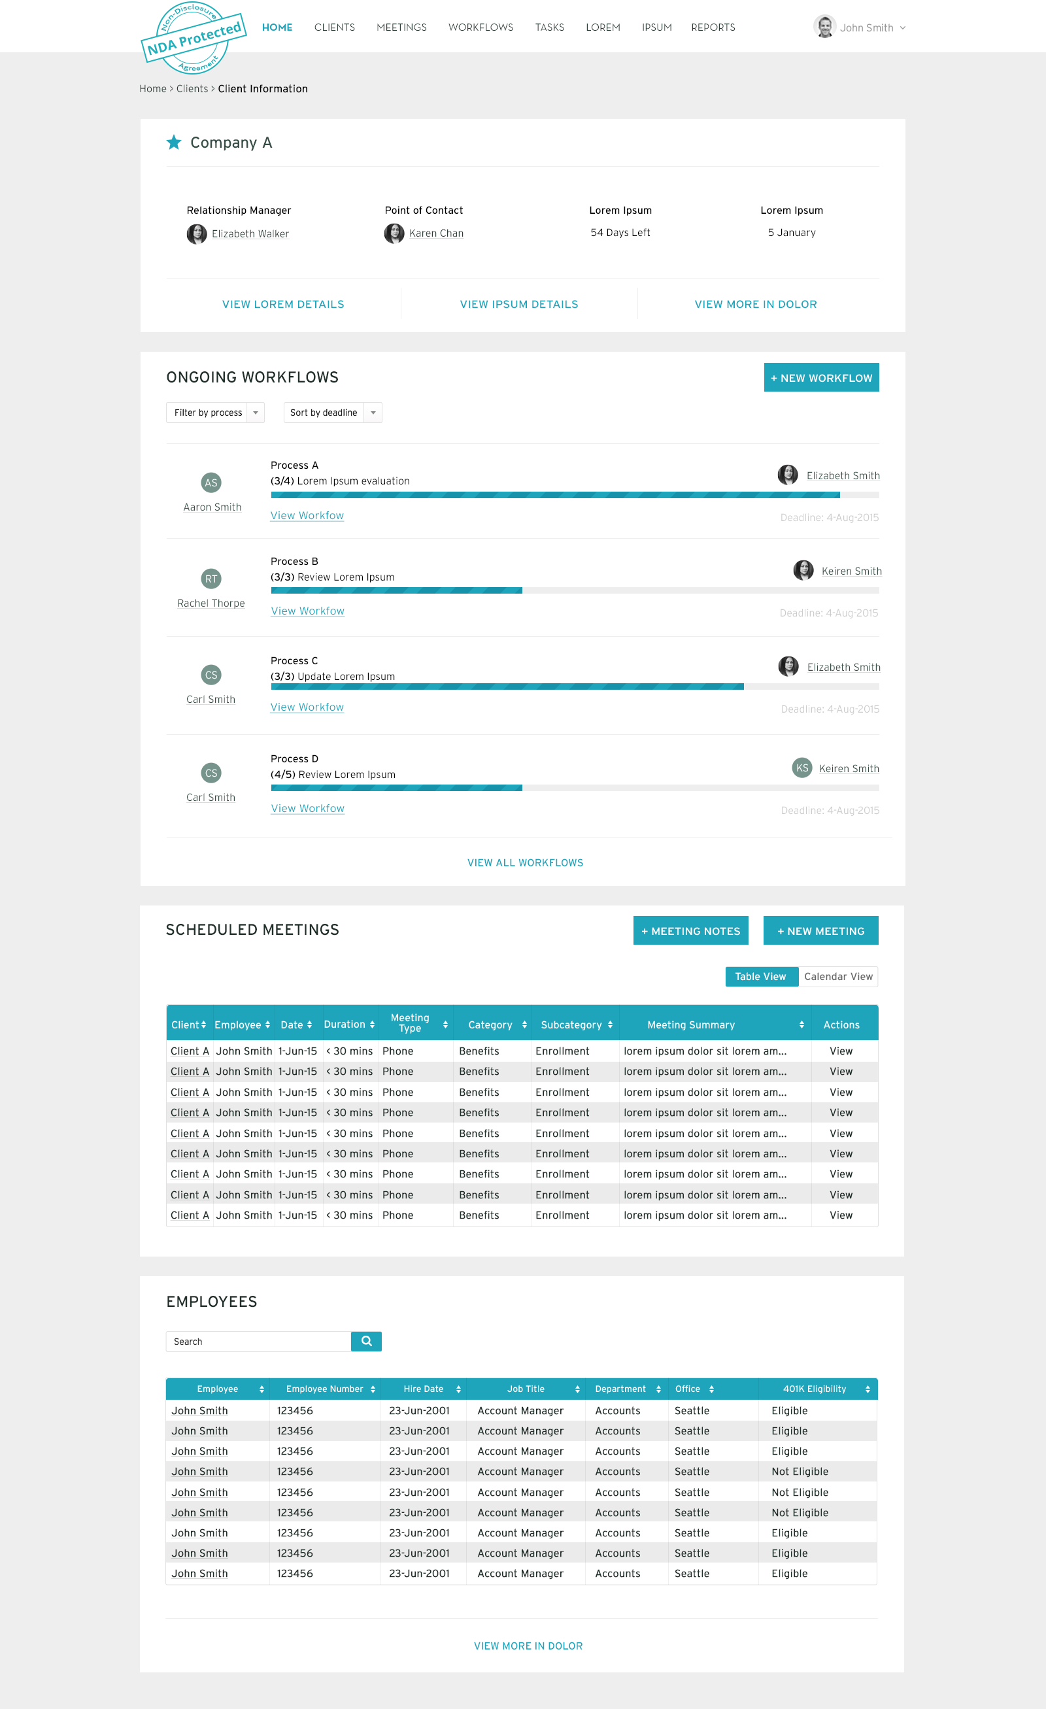
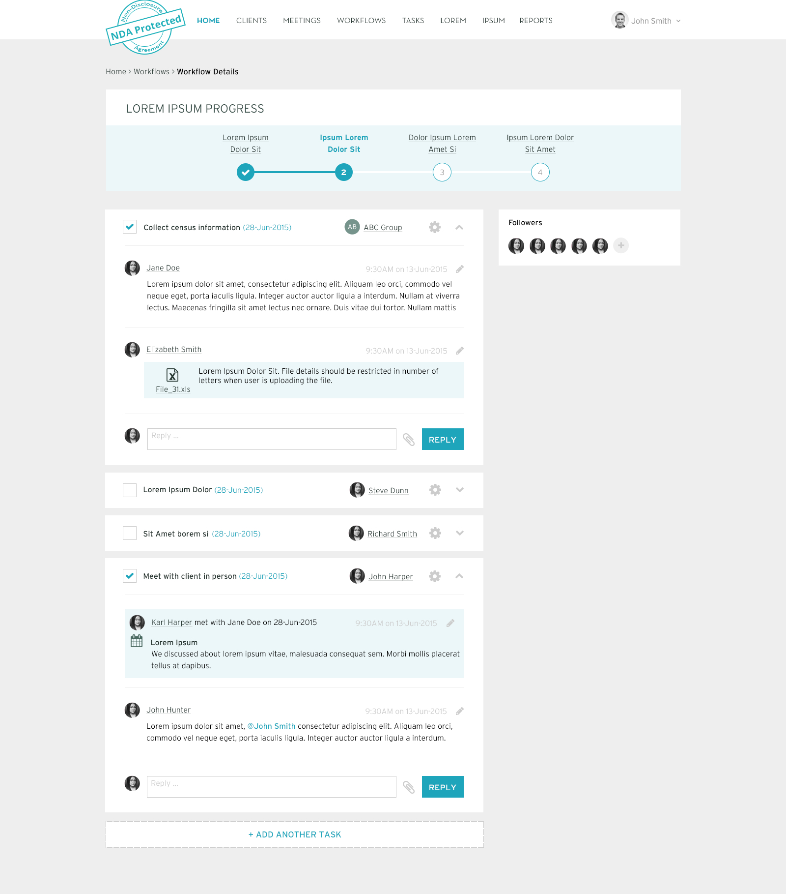
Client Information
Workflow Management

Slide 28
Challenges

Slide 29
What I’d Do Differently

